Slide 1
System Design
FINGERPRINT STUDENT ATTENDANCE MOBILE APP
GROUP 23

Slide 2
Table of contents
01
04
02
05
03
06
Introdction
Sequence Diagram
Context Diagram
Class Diagram
Use Case Diagram
Deployment Diagram

Slide 3
GROUP 23
Names | Matriculation Number
NDIFON LEMUEL ASHU-MBI | FE21A247
NGWASIRI RYAN TANIFIORM ONGA | FE21A266
NJIDDA SALIFU | FE21A272
ASONGNKWELLE COURAGE AYIM | FE21A142
NKWO BRAINIE NGONDA | FE21A282

Slide 4
01
Introduction
Explaining System Design

Slide 5
What is System Design?
System design refers to the process of defining the architecture, components, modules, interfaces, and data for a system to satisfy specified requirements.
It involves creating a blueprint for the system that addresses both functional and non-functional requirements and ensures that the system will operate efficiently and effectively.

Slide 6
Detailed Design
Context Diagrams
Use Case Diagrams
Sequence Diagrams
Class Diagrams
Deployment Diagrams

Slide 7
02
Context Diagram
Explaining Context of app

Slide 8
What is Context Diagram?
A context diagram is a high-level, graphical representation of a system and its interactions with external entities.
It is used in system analysis and design to provide a clear, concise overview of the system's scope and boundaries.

Slide 9
Components of Context Diagram
Main System
Context Diagram
External Entities
Data Flow

Slide 10
External Entities
Students
School Administration
Teachers
Database server
Main System
Fingerprint Student Attendance App

Slide 11
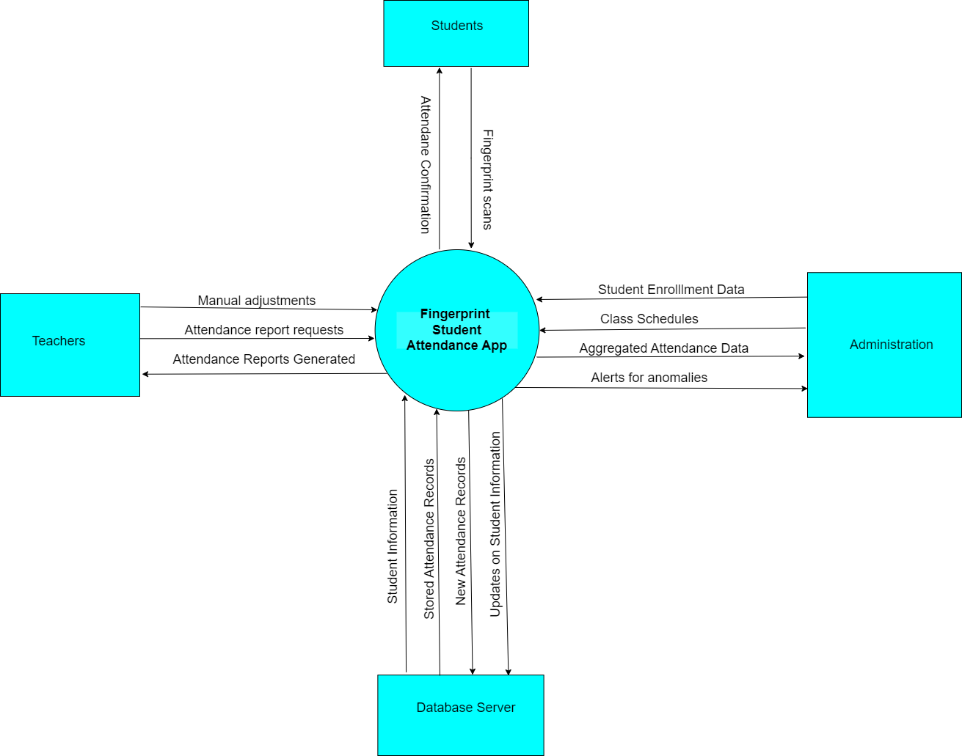
Context Diagram

Slide 12
Use Case Diagram
03
Explaining all use cases of the system

Slide 13
What is Use Case Diagram?
A use case diagram is a type of UML (Unified Modeling Language) diagram that visually represents the interactions between a system and its users (or "actors").

Slide 14
Actors and Use Cases
Actors
Some Use Csaes
Students
Login/Authenticate
Primary Actors
Mark Attendance
Secondary Actors
View Attendance Records
System Administrators
Faculty Members
Developers
Generate Attendance Reports

Slide 15
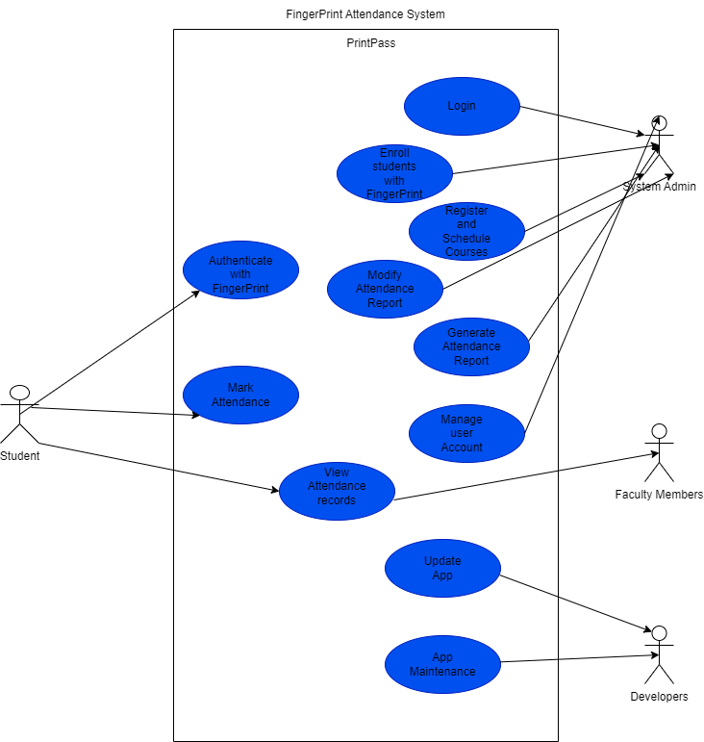
Use Case Diagram

Slide 16
Sequence Diagram
04
Explaining all interractions

Slide 17
What is a Sequence Diagram
A sequence diagram is a type of interaction diagram that shows how objects interact in a particular scenario of a business process or a system.
In our project , interractions exist for the admin , the student and other intergratable systems with the application

Slide 18
Components of a Sequence Diagram
1
Actors and Objects
5
Synchronous Message
2
Lifelines
6
Asynchronous Message
Activation Bars
7
Return Message
3
4
Messages
8
Combined Fragments

Slide 19
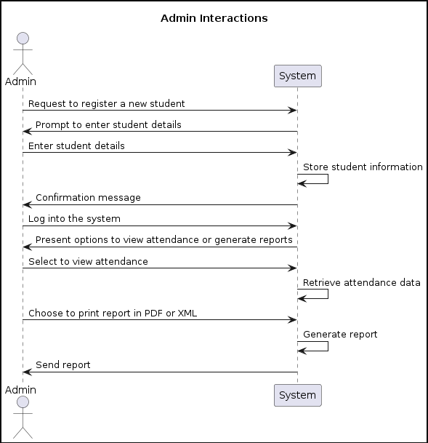

Slide 20
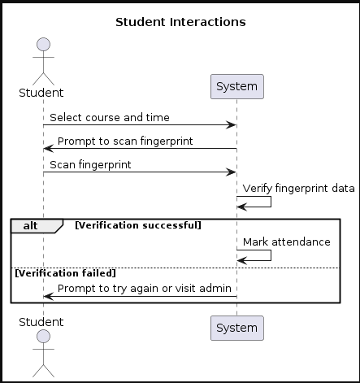

Slide 21
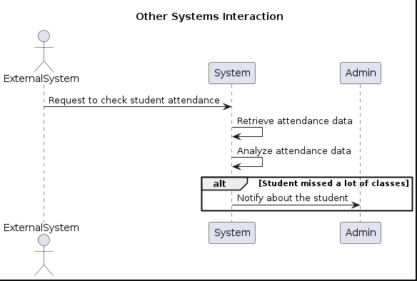

Slide 22
Class Diagram
05
Explaining relationship between classes

Slide 23
What Class Diagram Represents
A class diagram for a School Attendance Biometric Management System illustrates the system's structure, including
Classes
Attributes
Methods
Relationships between classes(including their cardinality)

Slide 24
Classes
Student Class
1
4
Admin Class
Holds student data and methods
Holds admin data and methods
2
Course Class
5
Attendance Class
Holds course data (object class)
Holds attendance data with respect to the course and student
3
Period Class
Holds data on day and time a course is taken

Slide 25
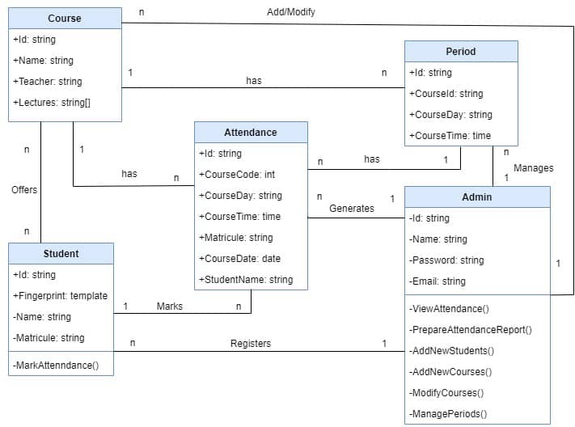
Class Diagram

Slide 26
Deployment Diagram
06
Explaining Deployment structure

Slide 27
What is a Deployment Diagram?
A deployment diagram is a type of structural diagram in the Unified Modeling Language (UML) that shows the physical arrangement of hardware and software components in a system.

Slide 28
Components of Deployment Diagram
Nodes
01
Physical hardware components and executable environments
02
Artifacts
Represent the concrete elements that are deployed on nodes
Communication Paths
03
Relationships and interactions between nodes

Slide 29
Mobile Device
Database Server
Nodes
Appication Server
Mobile Application
Artifacts
✓Server-side Application
Database

Slide 30
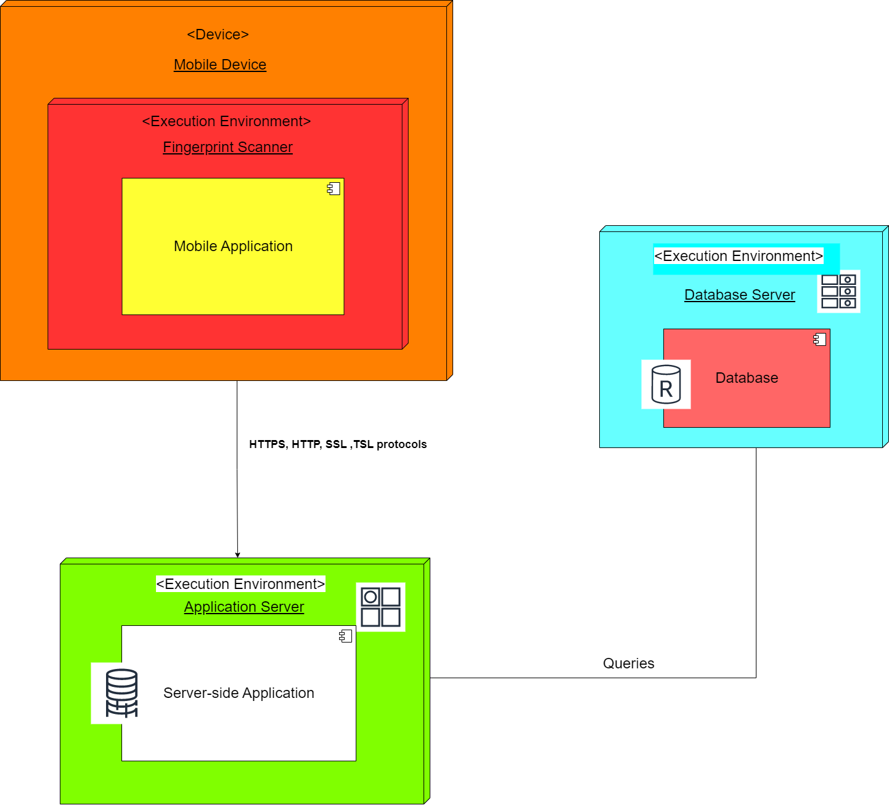
Deployment Diagram

